Slide 1
Case Study I
Amazing bank - Identifying Defaulters

Slide 2
Assumptions
To answer the questions a similar classification problem has been taken as a reference and the steps have been performed on a dummy dataset.
Kindly view the detailed solution along with example here.

Slide 3
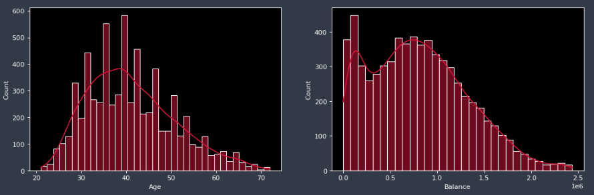
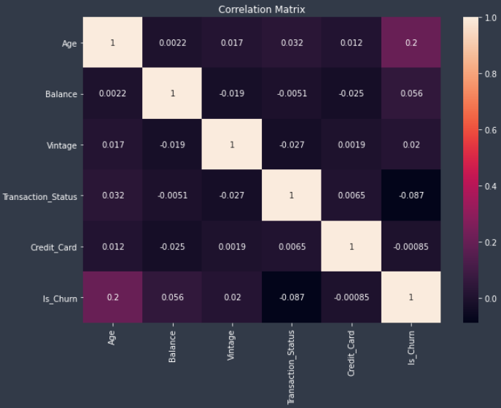
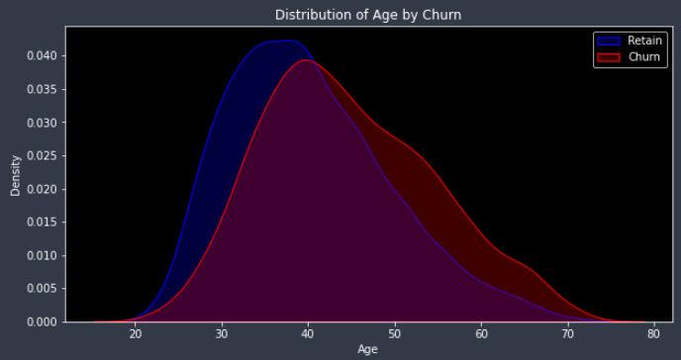
Key Insights
Fig 1
Fig 1: Age is almost normally distributed but
Balance is right skewed.
Fig 2: Elderly people are more likely to churn
Fig 3: Age is highly correlated with target column.
Other features are negligibly correlated
Fig 3
Fig 2

Slide 4
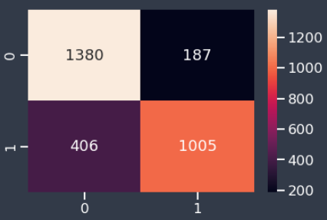
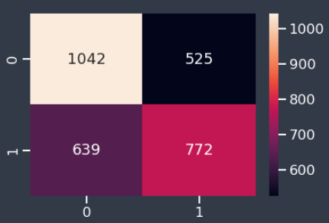
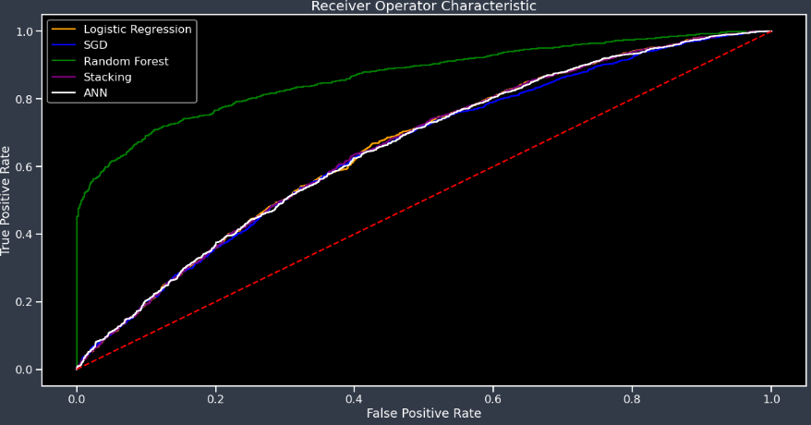
Model Comparison and Evaluation
Random Forest
Logistic Regression
ROC-AUC curve shows the model performance
by plotting the false positive rate to true positive rate
More the skewness of the curve towards the
upper left corner higher is the area under the
roc curve and better is the model performance
Random Forest showed a tremendous
performance but it is likely to overfit.
Stacking is basically a custom ensemble
technique where we can combine models of our choice.
Both Random Forest and Stacking are ensemble
techniques but there is a drastic difference in
their performance.
Most of the models have achieved around 64% accuracy
Model Comparison

Slide 5
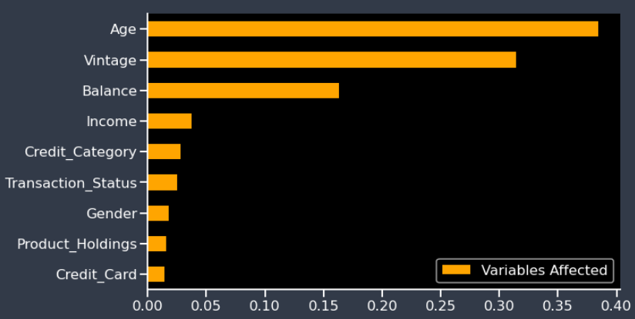
Conclusion
Feature Importance: It gives a very clear idea on which feature is the strongest in terms of determining the target variable.
From the above representation Age and Vintage feature are the most effective features. The bank should focus on these
features to reduce the churn rate. Also, the number of product holdings and whether a customer has a credit card
contributes the least in target prediction.
Summary: One important takeaway is new customers are more likely to churn and also customers with high income
are hard to retain. The Bank can focus on these 2 groups to bring down the churn rate.

Slide 6
Thank You!

